Slide 1
Instructions: Language of the Computer
‹#›

Slide 2
The Stored Program Concept
The stored program concept says that the program is stored with data in the computer’s memory. The computer is able to manipulate it as data—for example, to load it from disk, move it in memory, and store it back on disk.
It is the basic operating principle for every computer.
It is so common that it is taken for granted.
Without it, every instruction would have to be initiated manually.
‹#›

Slide 3
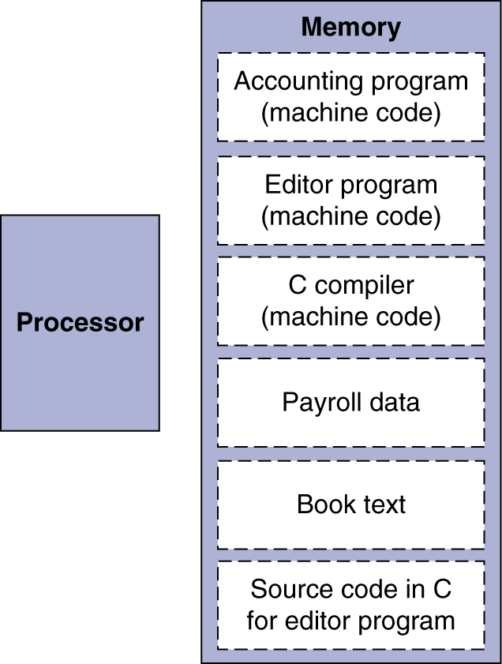
Stored Program Computers
Instructions represented in binary, just like data
Instructions and data stored in memory
Programs can operate on programs
e.g., compilers, linkers, …
Binary compatibility allows compiled programs to work on different computers
Standardized ISAs
Notes:
The University of Adelaide, School of Computer Science
*
Chapter 2 — Instructions: Language of the Computer
‹#›

Slide 4

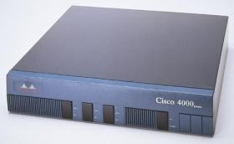
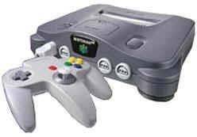
MIPS
In this class, we’ll use the MIPS instruction set architecture (ISA) to illustrate concepts in assembly language and machine organization
Of course, the concepts are not MIPS-specific
MIPS is just convenient because it is real, yet simple (unlike x86)
The MIPS ISA is still used in many places today. Primarily in embedded systems, like:
Various routers from Cisco
Game machines like the Nintendo 64 and Sony Playstation 2
‹#›

Slide 5
Assembly Language
Basic job of a CPU: execute lots of instructions.
Instructions are the primitive operations that the CPU may execute.
Different CPUs implement different sets of instructions. The set of instructions a particular CPU implements is an Instruction Set Architecture (ISA).
Examples: Intel 80x86 (Pentium 4), IBM/Motorola PowerPC (Macintosh), MIPS, Intel IA64, ...

Slide 6
Instruction Set
The instructions of a computer
Different computers have different instruction sets
But with many aspects in common
Early computers had very simple instruction sets
Simplified implementation
Many modern computers also have simple instruction sets

Slide 7
Assembly Variables: Registers (1/4)
Unlike HLL like C or Java, assembly cannot use variables
Why not? Keep Hardware Simple
Assembly Operands are registers
limited number of special locations built directly into the hardware
operations can only be performed on these!
Benefit: Since registers are directly in hardware, they are very fast (faster than 1 billionth of a second)

Slide 8
Assembly Variables: Registers (2/4)
Drawback: Since registers are in hardware, there are a predetermined number of them
Solution: MIPS code must be very carefully put together to efficiently use registers
32 registers in MIPS
Why 32? Smaller is faster
Each MIPS register is 32 bits wide
Groups of 32 bits called a word in MIPS

Slide 9
Assembly Variables: Registers (3/4)
Registers are numbered from 0 to 31
Each register can be referred to by number or name
Number references:
$0, $1, $2, … $30, $31

Slide 10
Assembly Variables: Registers (4/4)
By convention, each register also has a name to make it easier to code
For now:
$16 - $23 🡺 $s0 - $s7
(correspond to C variables)
$8 - $15 🡺 $t0 - $t7
(correspond to temporary variables)
Later will explain other 16 register names
In general, use names to make your code more readable

Slide 11
C, Java variables vs. registers
In C (and most High Level Languages) variables declared first and given a type
Example: int fahr, celsius; char a, b, c, d, e;
Each variable can ONLY represent a value of the type it was declared as (cannot mix and match int and char variables).
In Assembly Language, the registers have no type; operation determines how register contents are treated

Slide 12
Comments in Assembly
Another way to make your code more readable: comments!
Hash (#) is used for MIPS comments
anything from hash mark to end of line is a comment and will be ignored
Note: Different from C.
C comments have format /* comment */ so they can span many lines

Slide 13
Assembly Instructions
In assembly language, each statement (called an Instruction), executes exactly one of a short list of simple commands
Unlike in C (and most other High Level Languages), each line of assembly code contains at most 1 instruction
Instructions are related to operations (=, +, -, *, /) in C or Java

Slide 14
MIPS Addition and Subtraction (1/4)
Syntax of Instructions:
1 2,3,4
where:
1) operation by name
2) operand getting result (“destination”)
3) 1st operand for operation (“source1”)
4) 2nd operand for operation (“source2”)
Syntax is rigid:
1 operator, 3 operands
Why? Keep Hardware simple via regularity

Slide 15
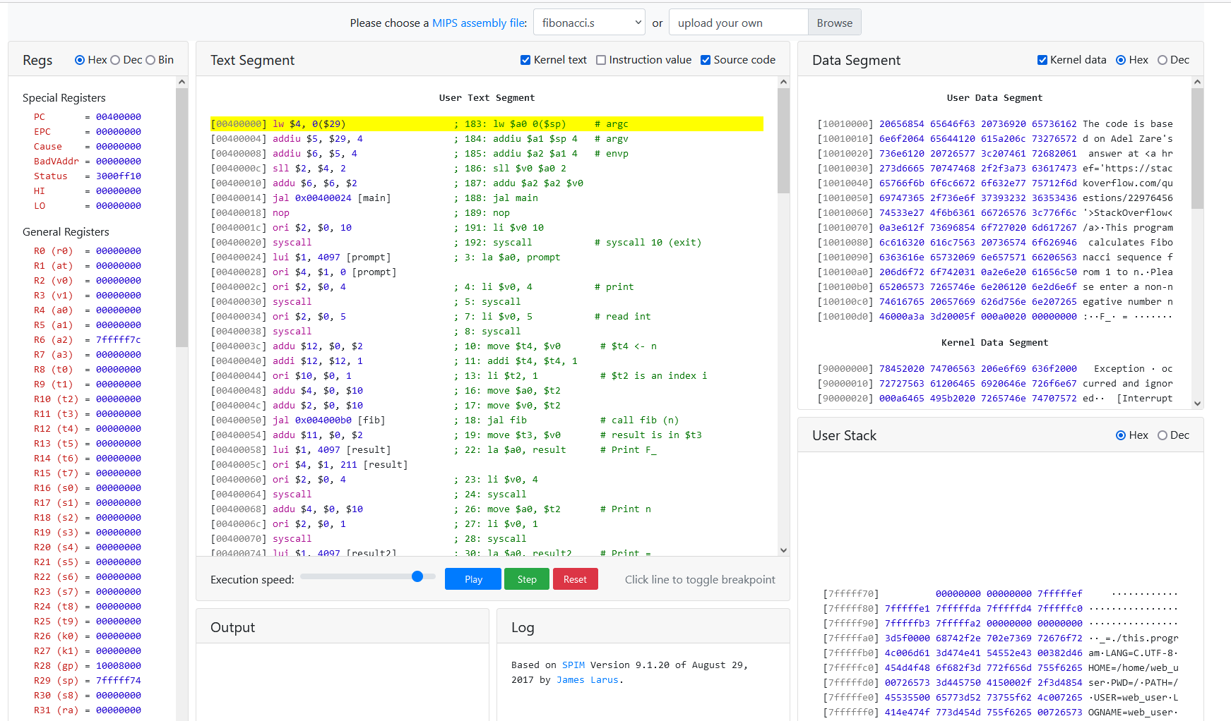
MIPS Development Environment
Any text editor
Different MIPS emulators, in this course I suggest
https://shawnzhong.github.io/JsSpim/

